Slide 1
A Time-aware Remote Data Mirroring Simulator
Dr.-Ing. Sebastian Götz
August 2023

Slide 2
Motivation
There is an RDMSim exemplar at SEAMS by Huma Samin et al.
This exemplar allows for stepwise simulation of a remote data mirroring system
The system supports adaptations, e.g., changing the topology
At each time step, the metrics of the system are computed as if the system is running
But, there is no running system simulating mirrors and their links
To measure the time required for an adapation action to be realized, we need a time-aware simulation (runtime model → managed system)
This is where the TimedRDMSim helps
To simulate the distribution of data packages in the network (e.g., models), we need an explicit object network, too.

Slide 3
Principle Idea
Create a network of mirrors
Connect the mirrors according to a strategy
Each mirror requires some time to to start and to be ready for communication
Mirror states: down → starting → up → ready → hasdata → stopping → stopped
Links between mirrors are established
Link states: inactive → active → closed
Links can only get active if their source and target mirror are ready
At runtime we can change the number of mirrors, the topology and the number of links

Slide 4
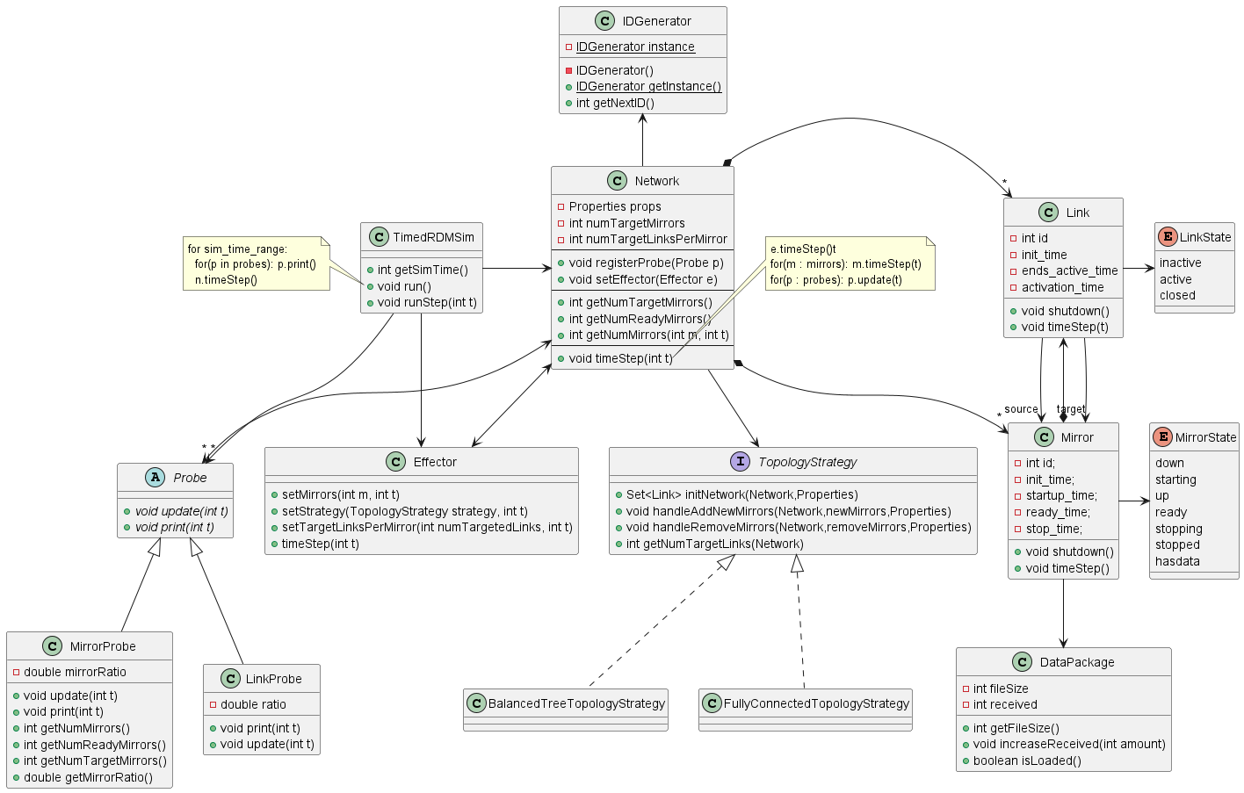
Framework Overview

Slide 5
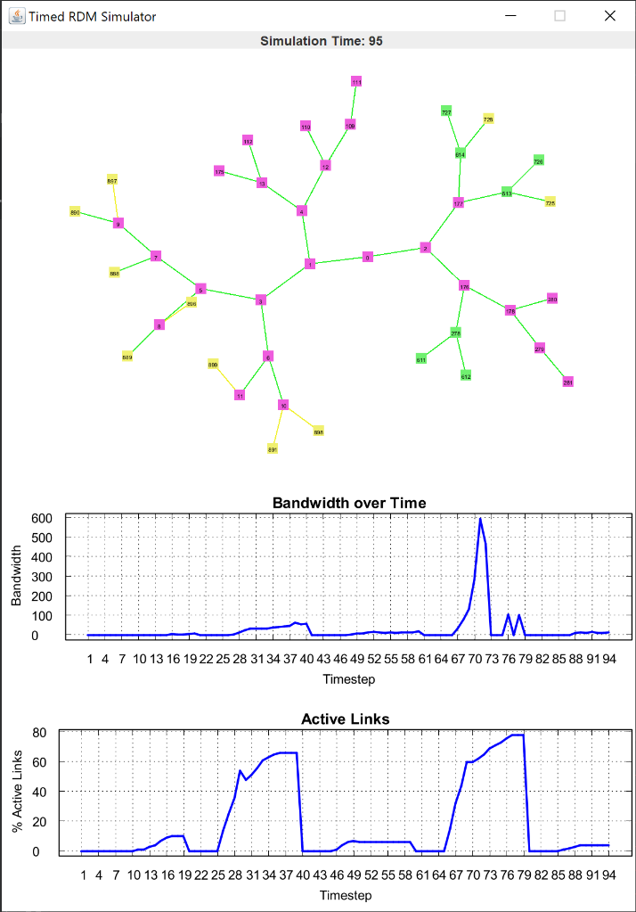
Visualization of Network
With GraphStream 2.0
State of mirrors and links is color coded
Yellow: inactive/starting
Green: active/ready
Red: closed/stopping
Purple: hasdata

Slide 6
Simulation Configuration (sim.conf)
debug=true
sim_time=200
num_mirrors=10
num_links_per_mirror=2
startup_time_min=5
startup_time_max=10
ready_time_min=2
ready_time_max=20
stop_time_min=2
stop_time_max=5
link_activation_time_min=5
link_activation_time_max=10
fileSize=80
min_bandwidth=2
max_bandwidth=8

Slide 7
How to describe scenarios?
Write a Simulation Runner (main)
public static void main(String args[]) { TimedRDMSim sim = new TimedRDMSim(„resources/sim.conf“); sim.initialize(new BalancedTreeTopologyStrategy()); Effector effector = sim.getEffector(); //change mirrors to 10 at timestep 40 effector.setMirrors(10, 40); //change to fully connected topology at timestep 70 effector.setTopology(new FullyConnectedTopologyStrategy(), 70); sim.run(); }

Slide 8
Self-adaptation
The system can be controlled via its effector and observed via probes
Two important metrics
Number of active links → reliability
Bandwidth used by the overall network → cost
A fully connected topology leads to the best reliability, but also to the highest cost
A balanced tree toplogy leads to less reliability, but also less cost
The number of links per mirror allows to in- or decrease reliability and cost

Slide 9


